Slide 1
Predicting loan approval of a Customer

Slide 2
Predicting Loan Approval is Important
Normally companies have a lengthy process to approve loan.
It helps predict the approval of a loan application for a customer.
It helps the company to provide better and confident service to the customers.
This can also help the customer to know what will be the result of their loan application.

Slide 3
Data acquisition and cleaning
I took the data set from this link : https://datahack.analyticsvidhya.com/contest/practice-problem-loan-prediction-iii/download/test-file
This data set had missing values.
So, For different feature I have applied different method such as mean of the feature, mode of the feature etc..
This data set has 614 rows and 13 features.

Slide 4


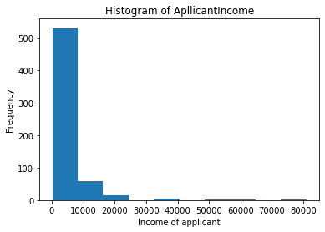



Frequency of loan application for Customer with different Income
Most number of loan application are from customer with low income.

Slide 5
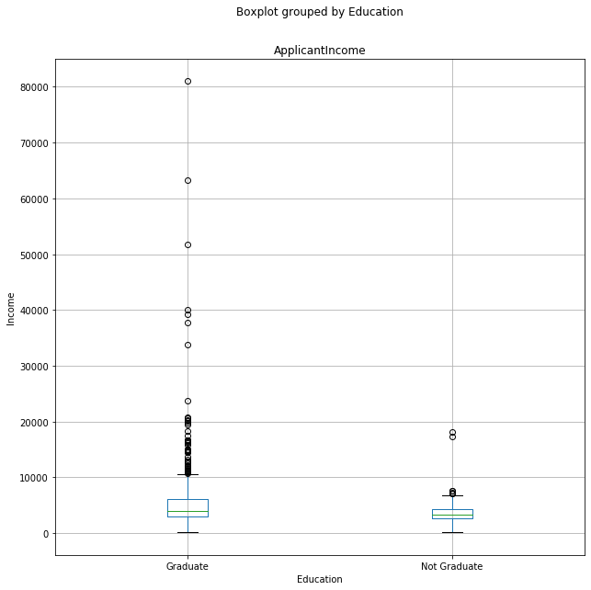
Income and Loan Approval
Only applicant income doesn’t play a major role in loan approval. As we can see the mean of both approval and rejection is almost same.

Slide 6
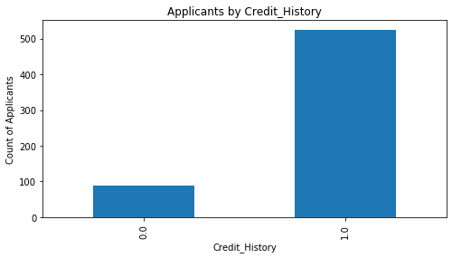
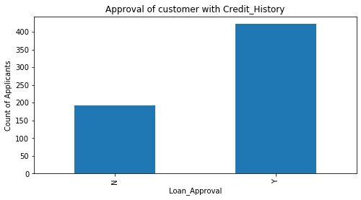
Customer with Credit history are more likely to apply for loan
The applicant who have a credit history also have a higher chance of loan approval.

Slide 7
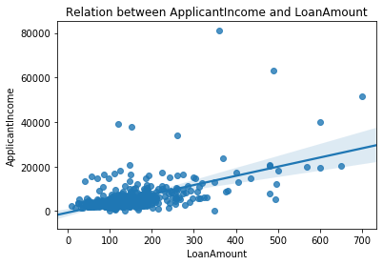

Slide 8
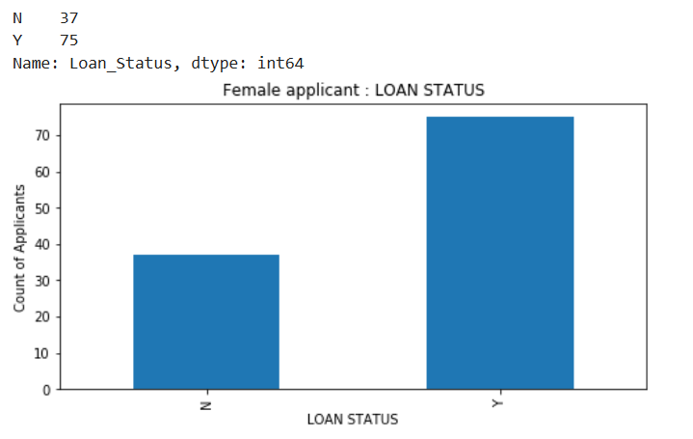
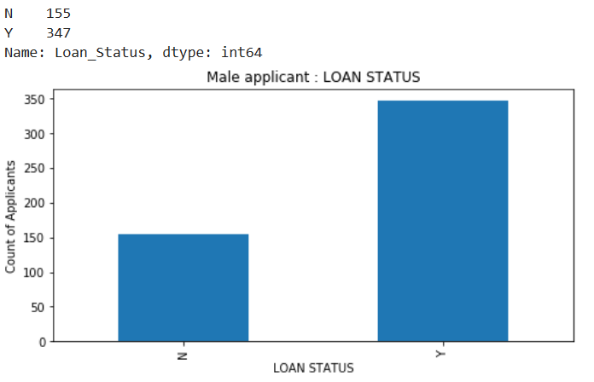
Male applicant have a higher chance of loan approval
Percentage approval for male is higher than female

Slide 9
Predictive Modeling
As we have to predict result according to the pattern already happening in this problem, we will use Supervised machine learning.
Also in Supervised learning, we have :-
Regression :- It is used to predict the value of a continuous variable
Classification :- It is used to predict the value of a categorial variable
We have to predict Loan_Status which is a categorial variable. So, we use classification.
For this problem I am using Logistic Regression

Slide 10
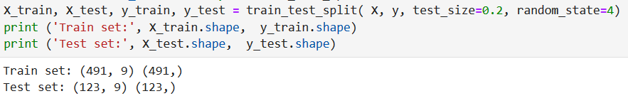
Split the Data set : Test & Train
We take 20% of the data(123 entries) set for testing. And rest of the dataset (491 rows) is used to test the model.

Slide 11
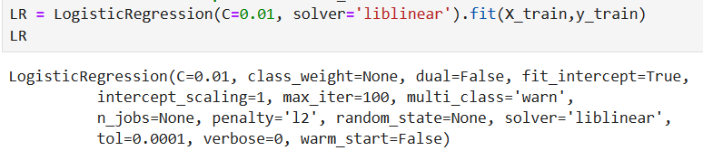
We train the model on training set with logistic regression

Slide 12

The error in prediction of test data set
We are taking Jacard’s Similarity index for error calculation.
If all prediction are right : Jacard’s Similarity index = 1.0

Slide 13
Conclusion
Built useful models to predict whether loan will be approved or not.
Accuracy of the models has room for improvement.
More feature should be included such as Age, Years of job left etc..

